Slide 1
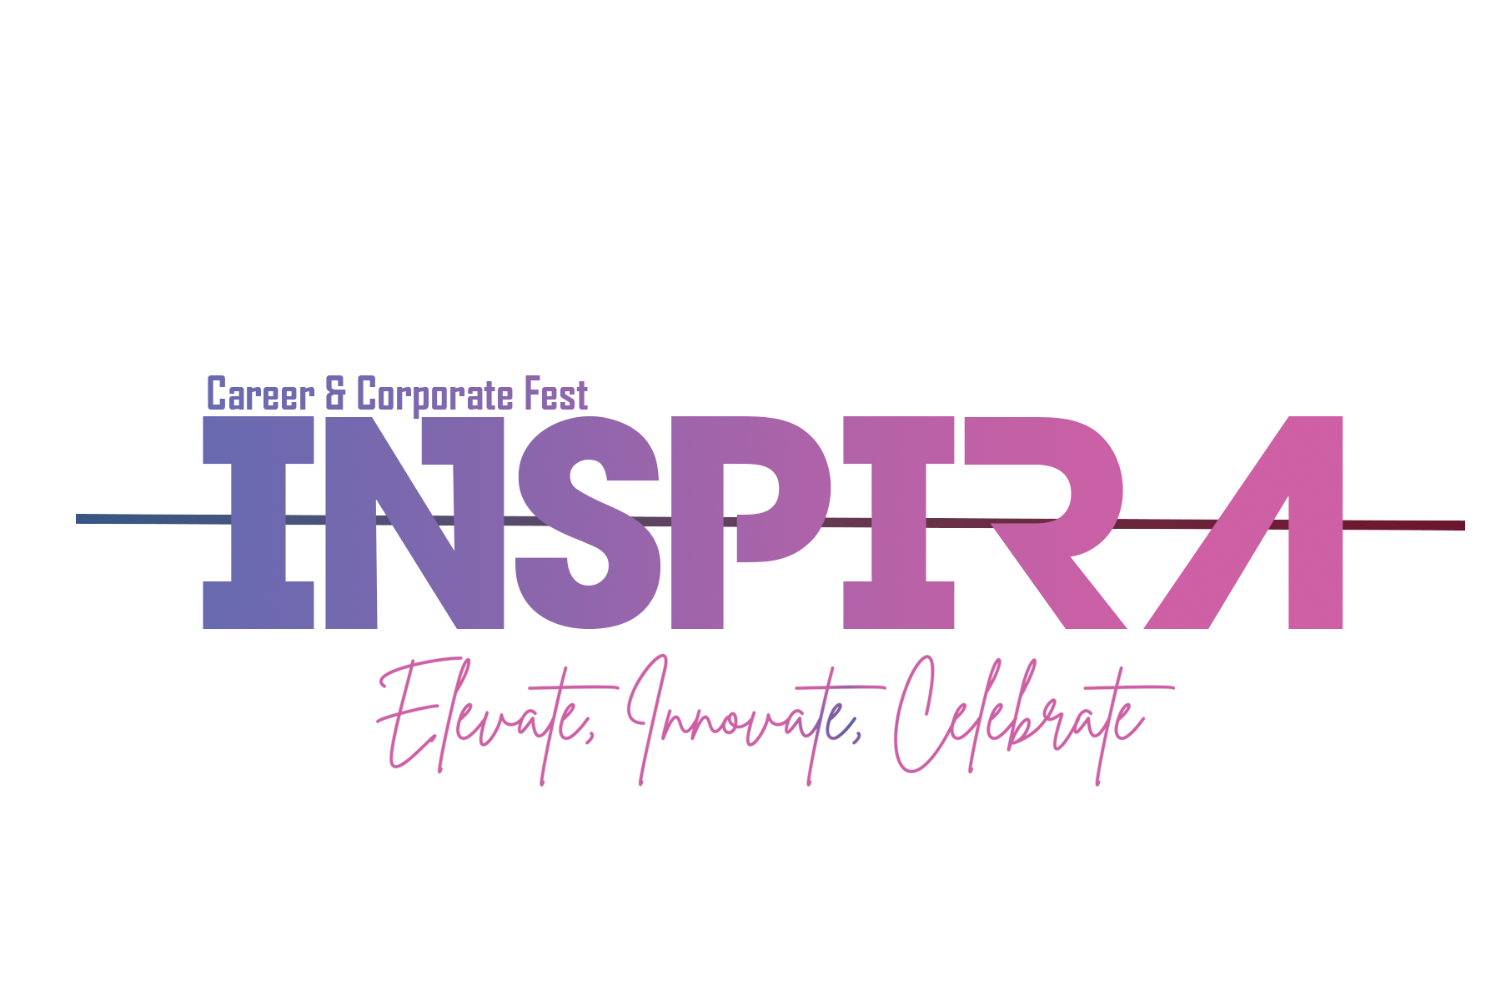

FORGE INSPIRA’25
HACKATHON
reallygreatsite.com

Slide 2

PROBLEM STATEMENT
Students and professionals struggle to get personalized career guidance
Manual resume analysis is time-consuming and inconsistent
SKILL GAP IDENTIFICATION REQUIRES EXPERT KNOWLEDGE
LIMITED AI-POWERED CAREER DEVELOPMENT TOOLS

Slide 3

IS THERE A SOLUTION TO THIS PROBLEM ?
YES THERE IS ...

Slide 4
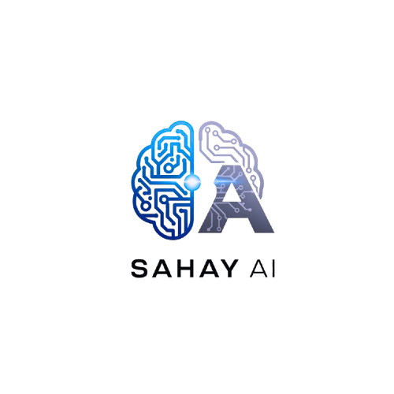
SOLUTION
IS AN INTELLIGENT CAREER MENTOR THAT COMBINES ADVANCED AI TECHNOLOGY WITH USER-FRIENDLY DESIGN TO PROVIDE PERSONALIZED CAREER GUIDANCE, RESUME ANALYSIS, AND SKILL DEVELOPMENT RECOMMENDATIONS.

Slide 5
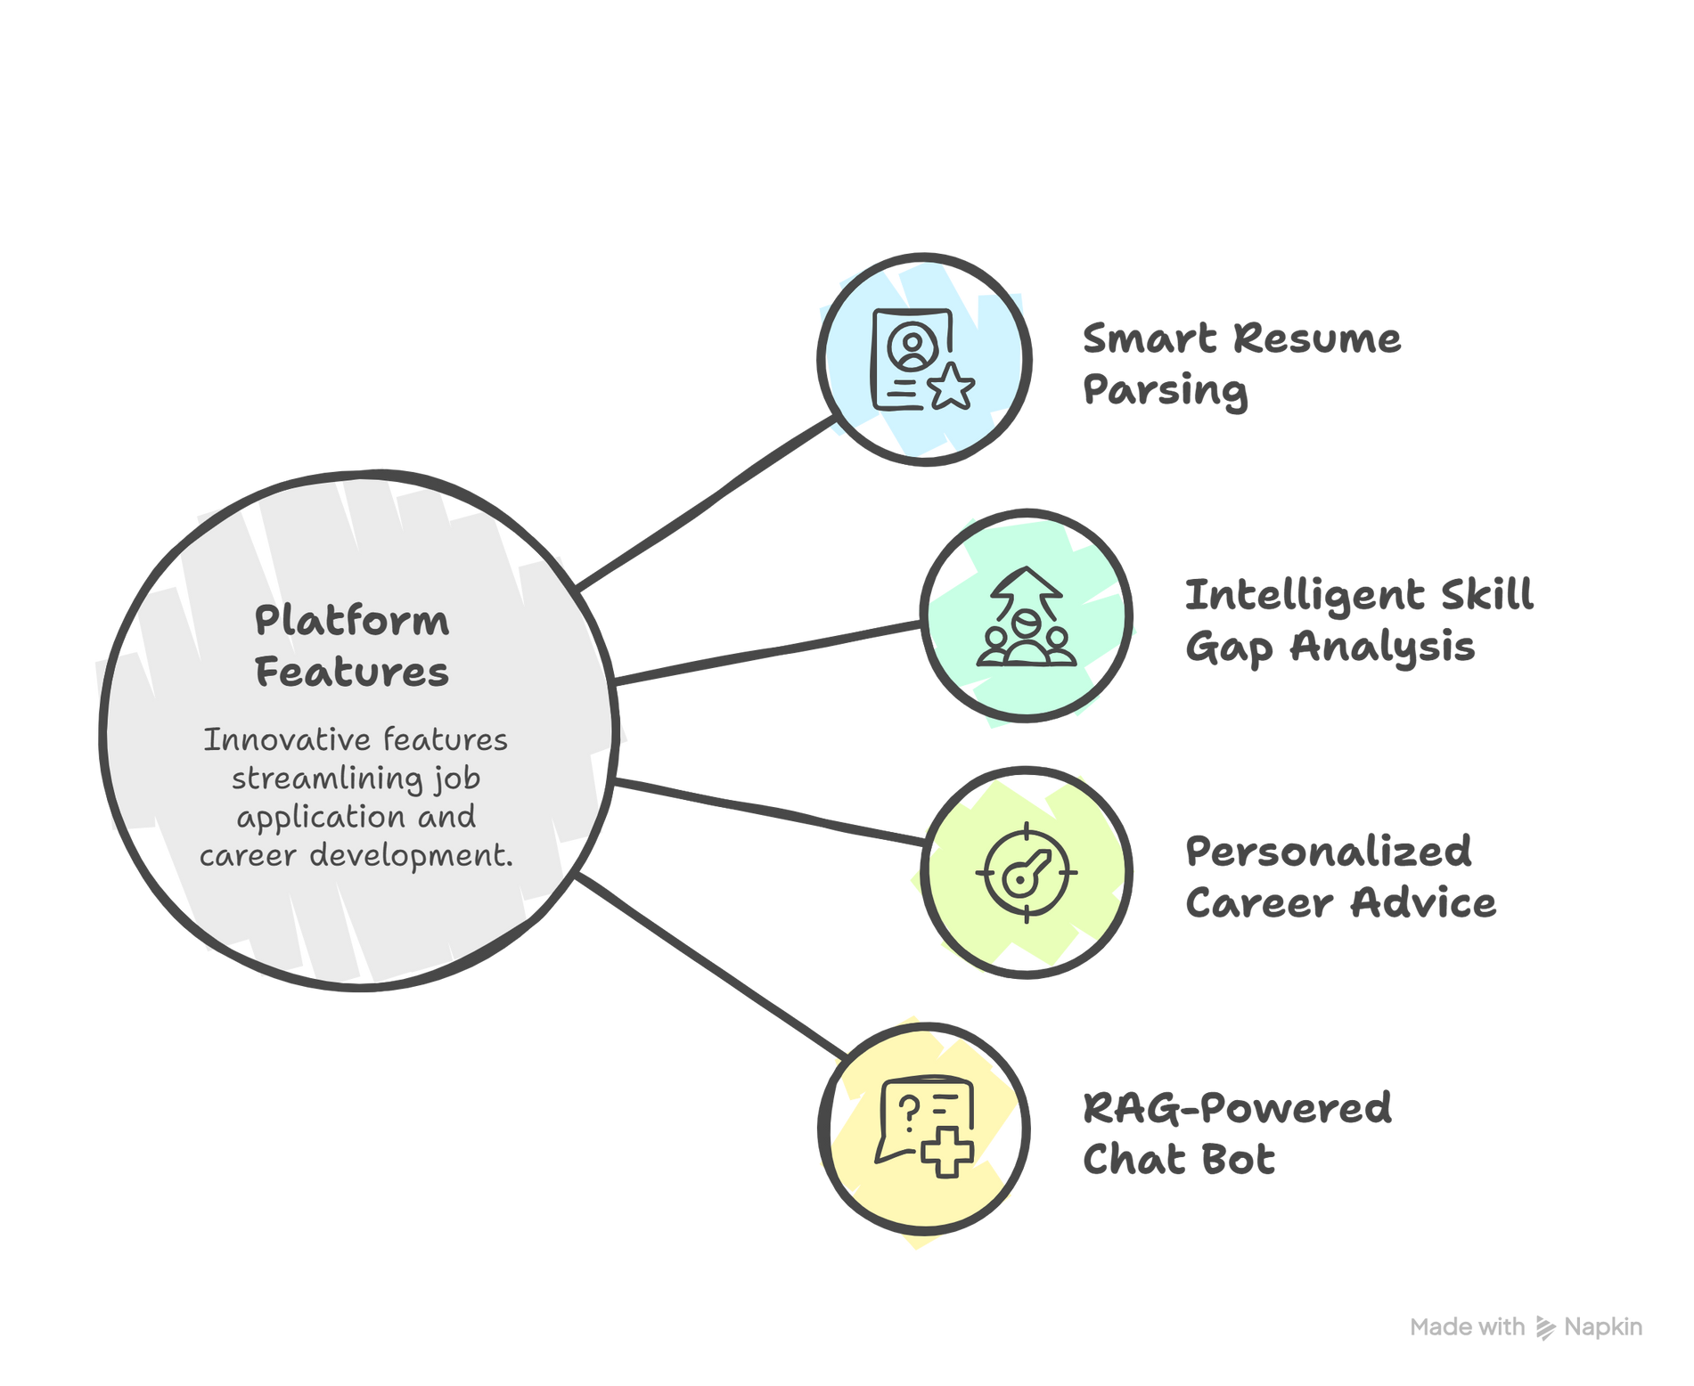

Slide 6
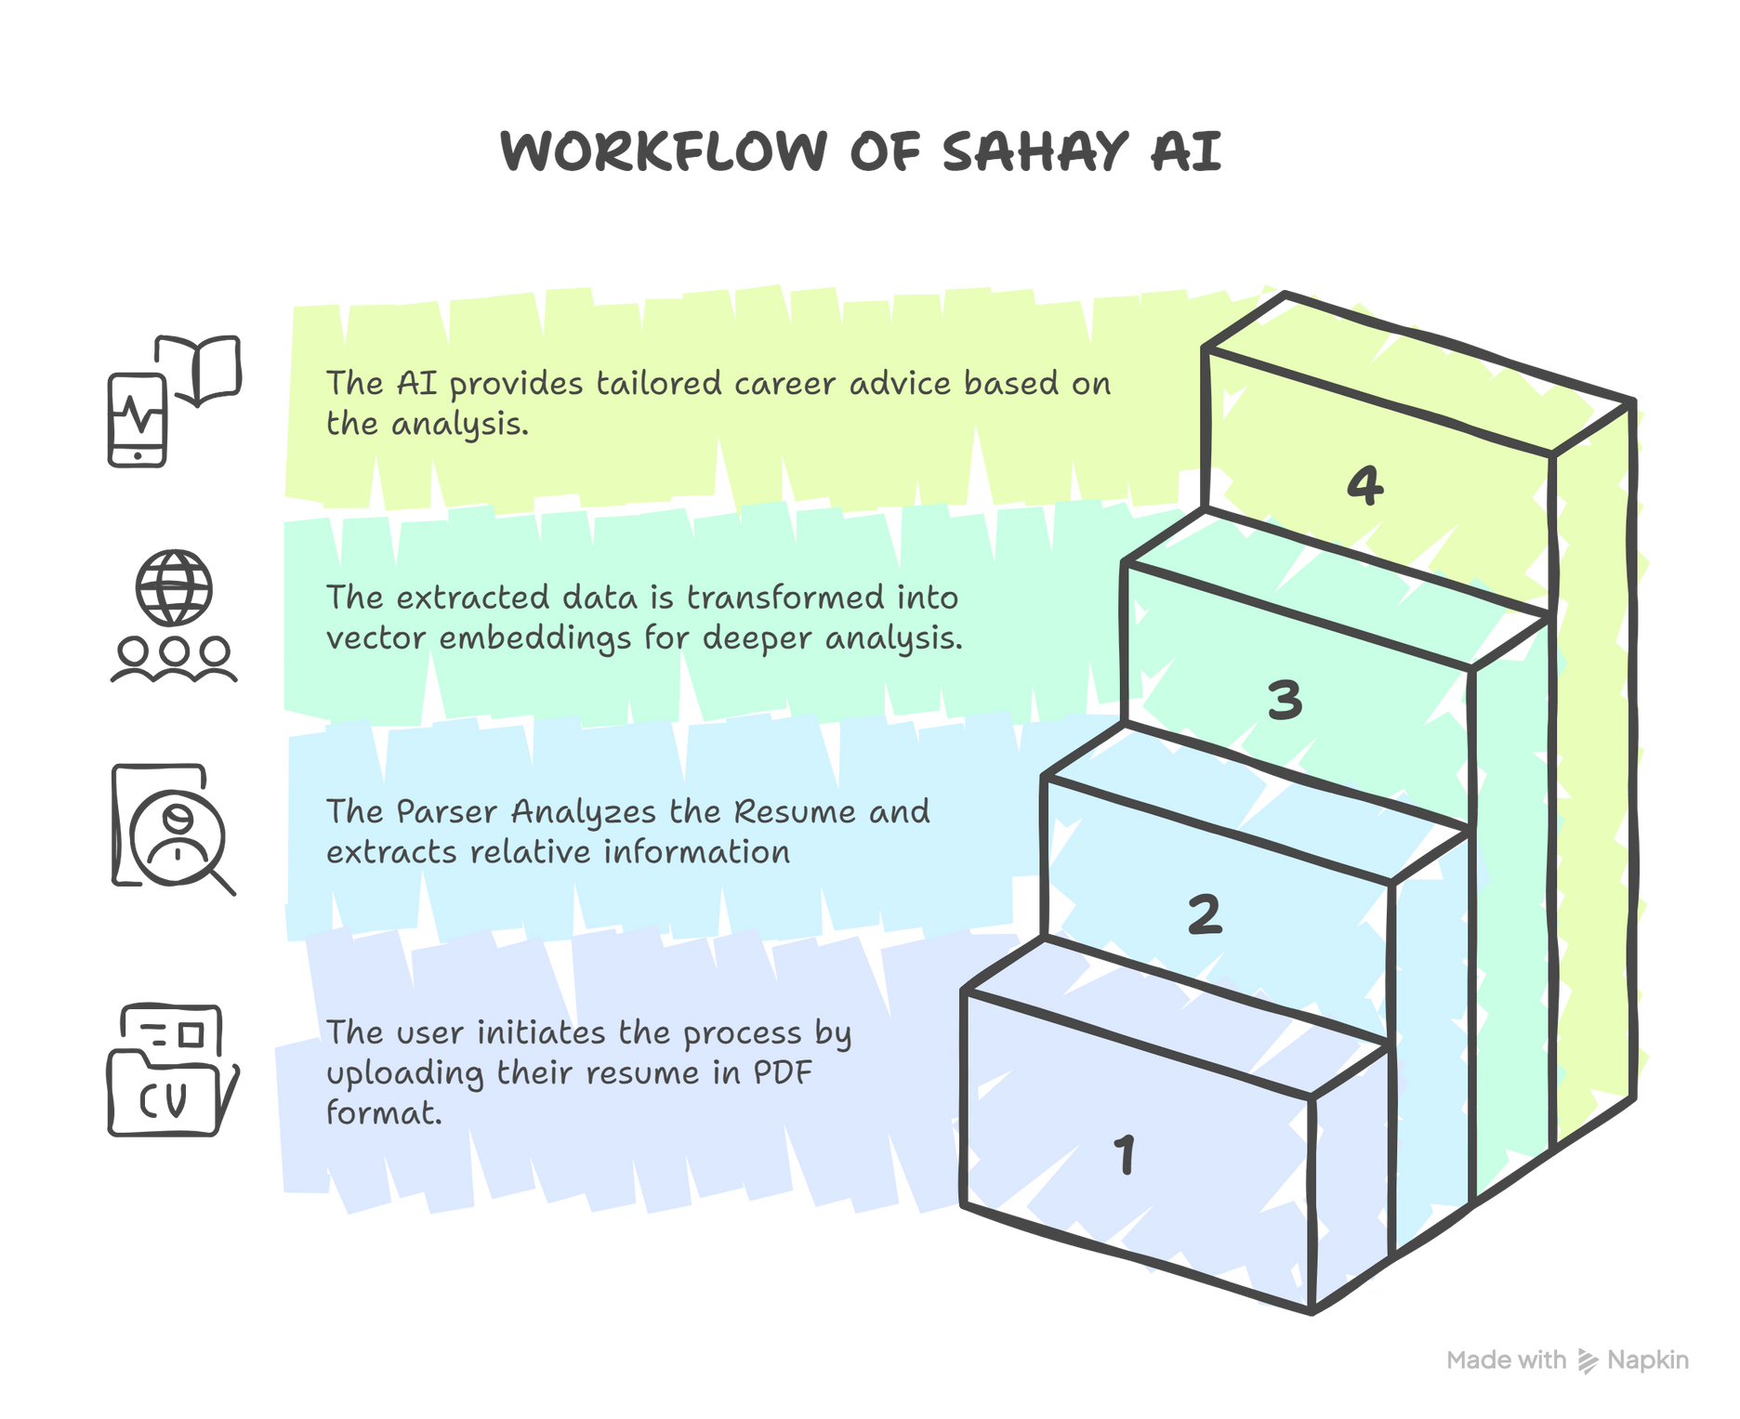

Slide 7
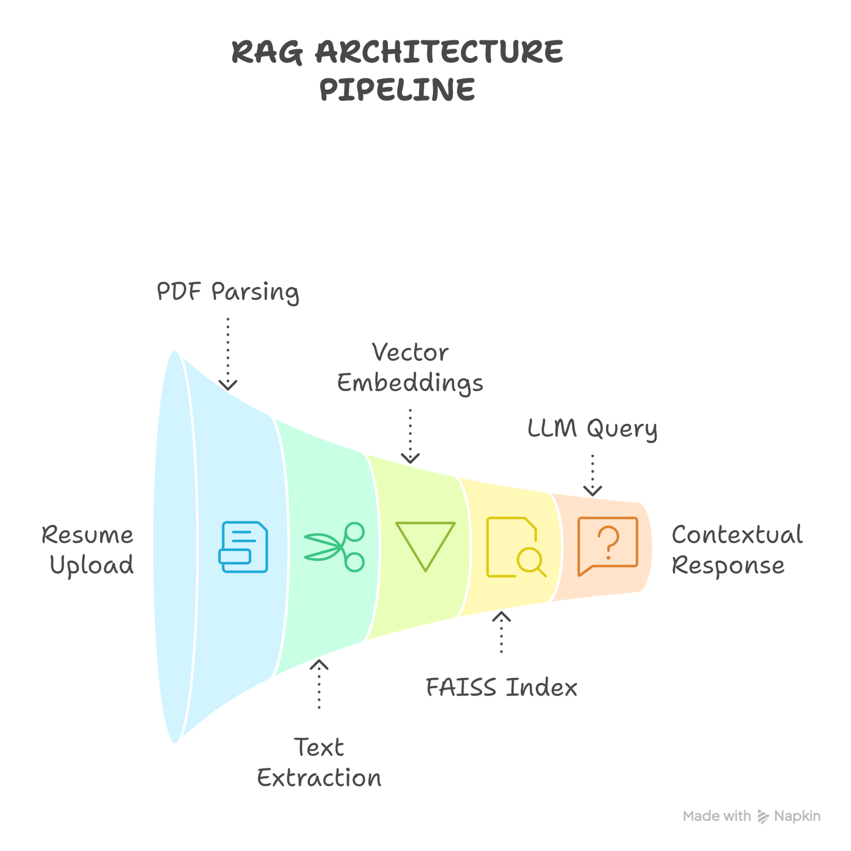
RAG ARCHITECTURE PIPELINE

Slide 8

USER VALUE
Career Guidance: Personalized AI recommendations
Skill Development: Gap analysis and learning paths
Resume Optimization: Quality assessment and suggestions
Professional Growth: Long-term career planning

Slide 9
TECH STACK
Frontend : HTML5/CSS3, Bootstrap 5,JavaScript
Backend : Django 5.0+, PyMuPDF, LangChain, HuggingFace ,FAISS

Slide 10
AI/ML
DialoGPT-small: Optimized language model
ONNX Runtime: Performance optimization
CPU Optimization: torch.float32, low_cpu_mem_usage

Slide 11
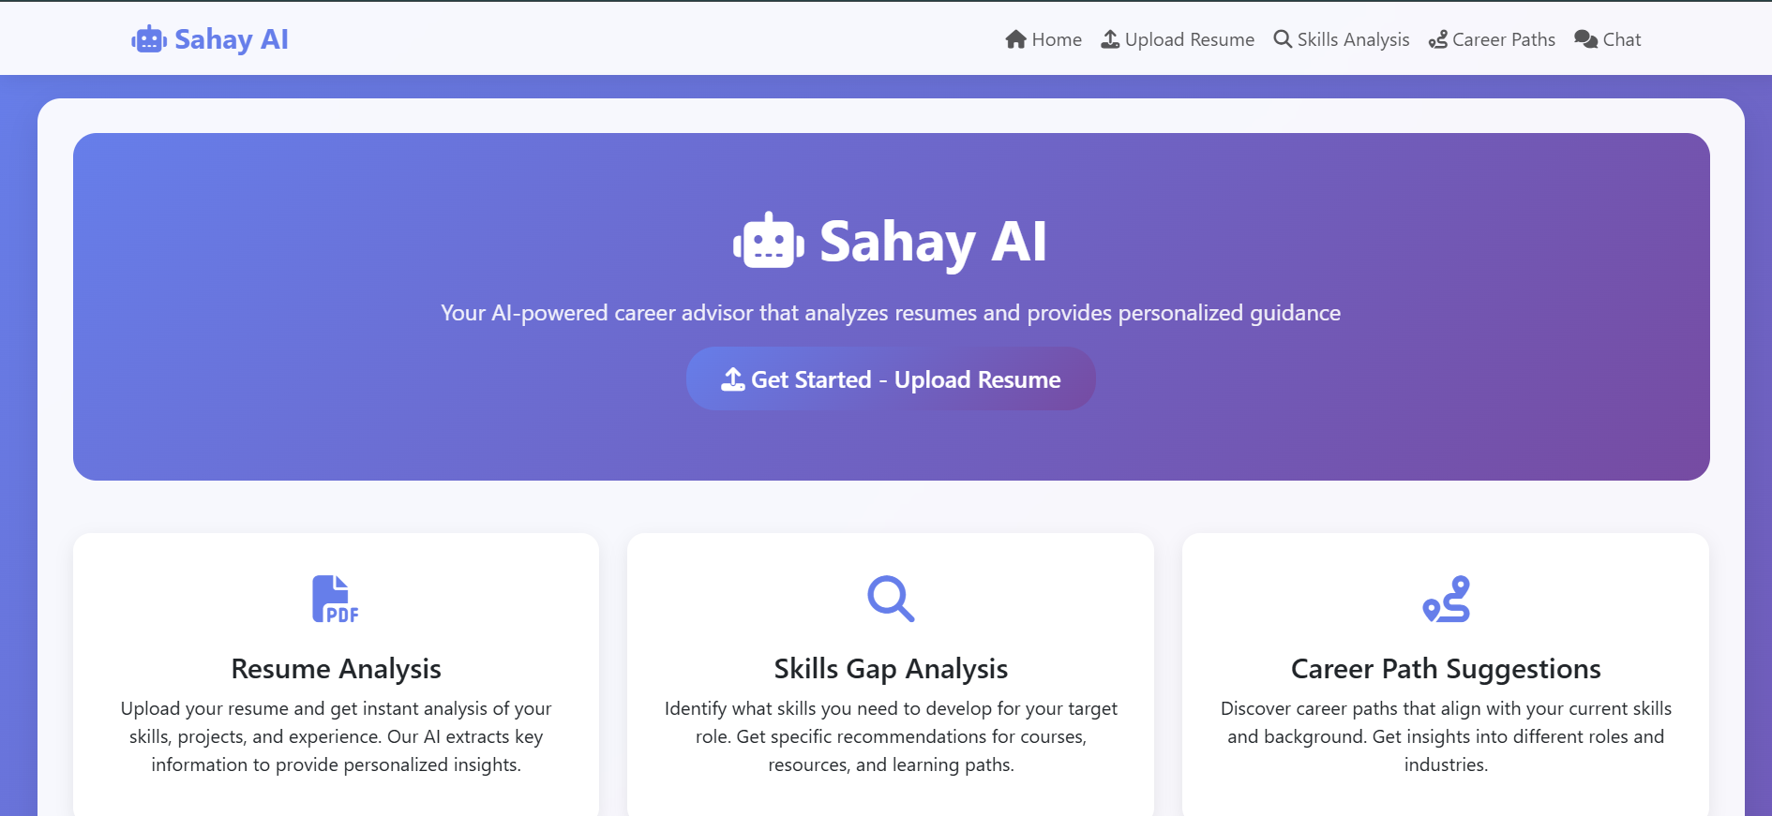

Slide 12
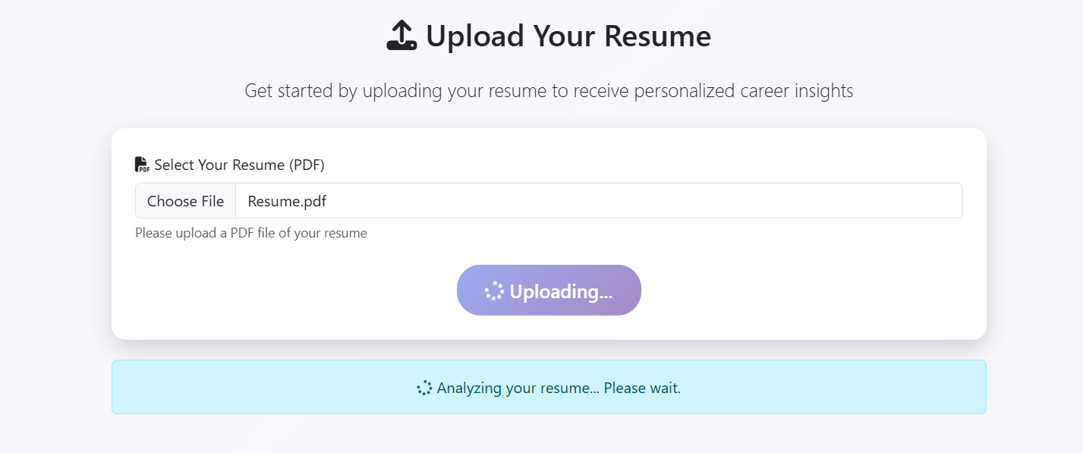
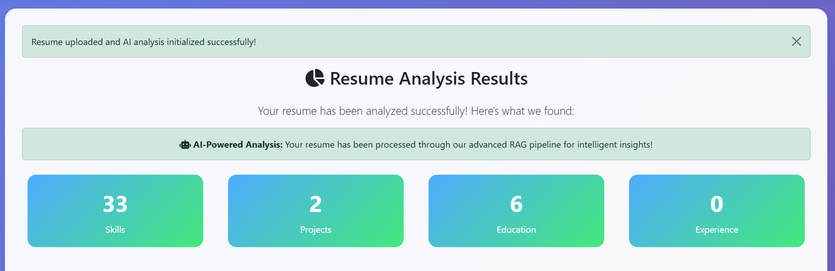

Slide 13
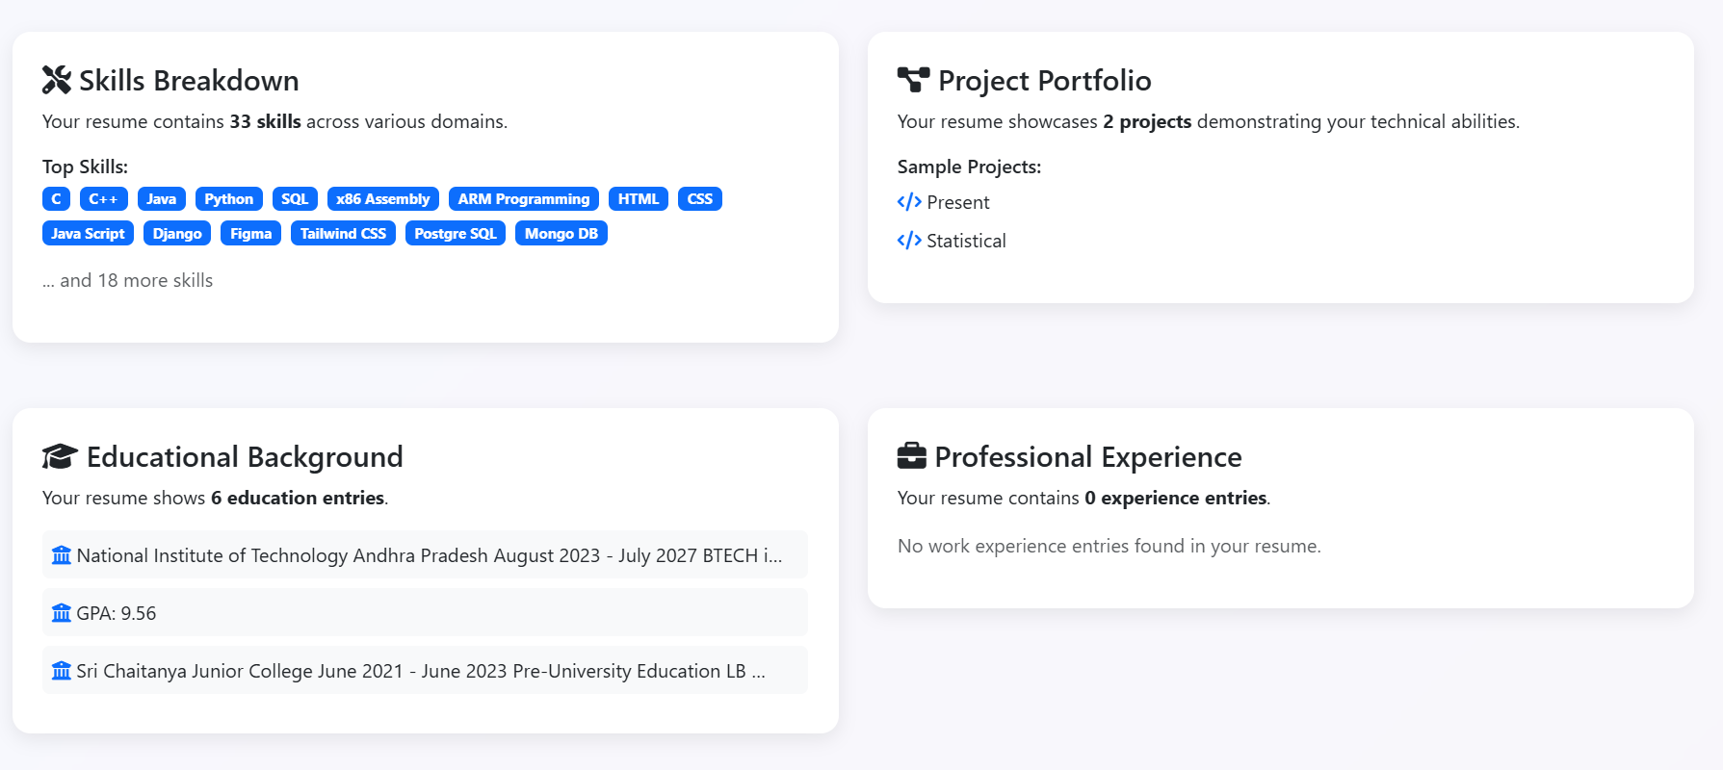
For more detail about the functioning refer the GitHub repohttps://github.com/SOHAM-3T/SAHAY_AI.git

Slide 14
THANK YOU

